Slide 1
Limitless Reach Brings New Challenges in Evaluation
Kristi L. Ladowski, MPH
Injury Prevention & Outreach Coordinator
Stony Brook Trauma Center
Stony Brook University Hospital
Dunya Hamdan
Masters in Public Health Student
Stony Brook University
Process Evaluation/Streamline
Han Wang
Masters in Public Health Student
Stony Brook University
Outcomes Evaluation

Slide 2
Tai Chi: Pre-Covid

Slide 3
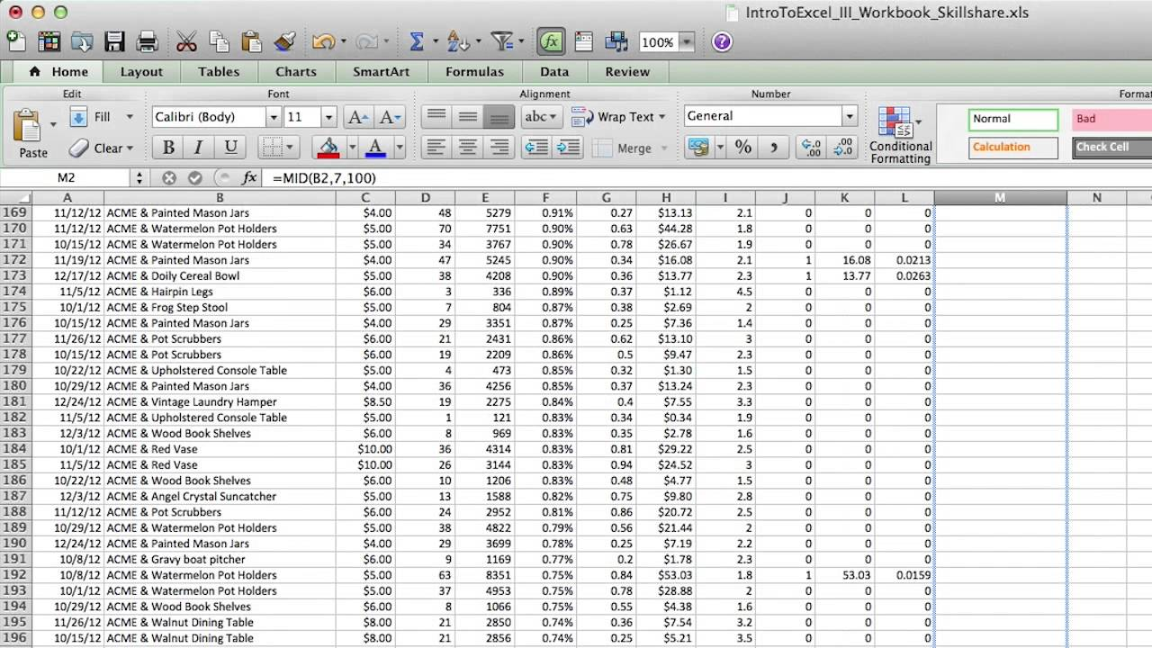



In-Person Workshops
and Data Collection
Collect Data Forms at Class 1
~100% Completion
Manual Data Entry
Single Data Export
Notes:
Discuss how we would collect all the surveys and attendance with pen/paper
Then volunteer would manually enter all the data in a database
Pros: All data easily exported into one excel sheet to be analyzed, nearly 100% survey completion pre-surveys
Cons: (consider asking audience)
Time consuming
Delays in obtaining data for analysis
Mistakes

Slide 4
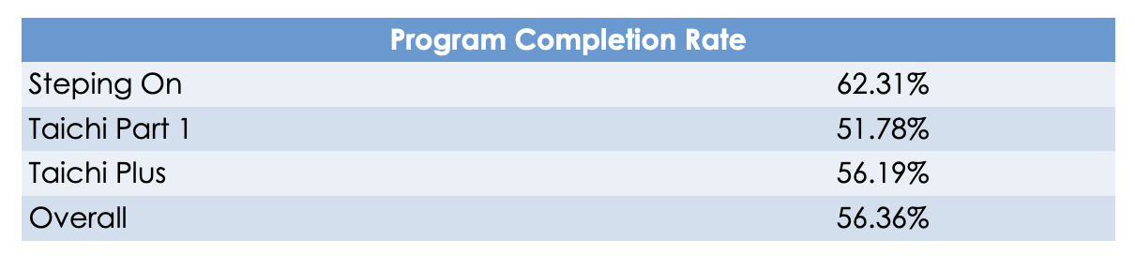
Completion Rate of In-Person Workshops
Difference in completion rate indicates that the length of the program and content of the program may influence the participation.
Notes:
Program completion rate is calculated based on their attendance.Taichi classes are offered in different levels, including Taichi Part 1 and Taichi Plus. Taichi has 16 classes in total; if participants attend 11 or more classes, they are considered a completer. As we can see from table 2, the completion rate varies by type of program. Difference in completion rate indicates that the length of the program and content of the program may influence the participation
The overall program completion rate is 56.36% which indicates that about a half of participants didn’t actively participate in the program. The further steps for data analysis are seeking for evidence for how to improve program completion rate. We are currently testing if a program with different parts, like Taichi, would have a better completion rate. Our hypothesis is that people who register for multiple sessions would have a higher completion rate.

Slide 5
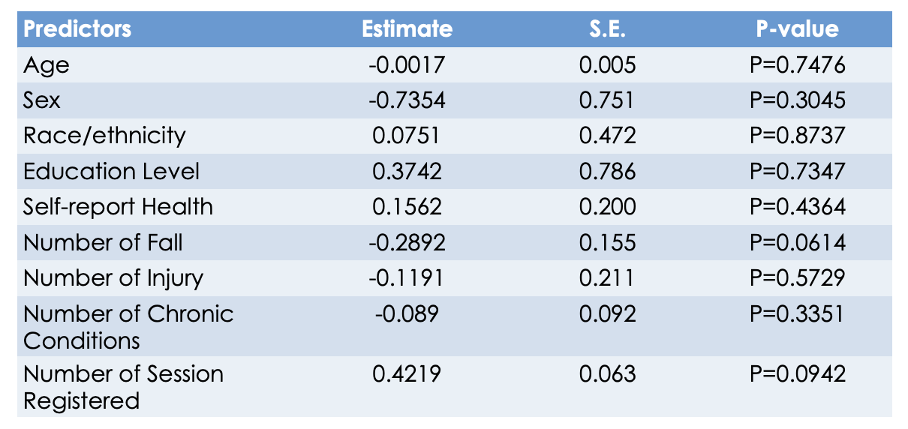
Association between Completion Rate and Predictors
Notes:
A logistic regression is performed using the program completion rate as the outcome and multiple predictor variables that influence the attendance. The program completion rate is positively associated with race/ethnicity, education level, self-report health, the number of sessions registered and negatively associated with age, sex, number of fall, injury, and chronic conditions. Due to the special data structure, most predictors are not statistically significant, but it provides meaningful information and points out the direction for the design of the fall prevention program.

Slide 6
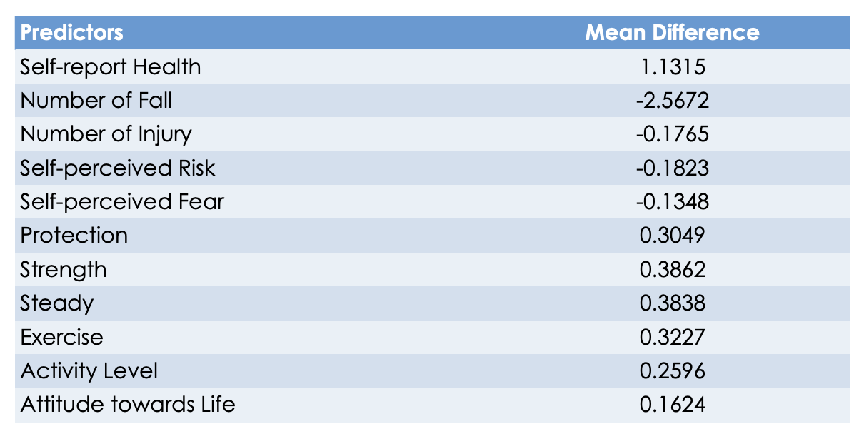
Program Impacts
Notes:
For the purpose of program evaluation, the paired sample t-test is performed to determine the program impact. Pre/post survey responses are compared to evaluate the mean difference of the predictor. We observe improvement in health status, protection, strength, steady, exercise, activity level, and attitudes towards life. There is a decrease in the number of fall, injury, and self-perceived risk and fear.

Slide 7
Then COVID…
Notes:
Covid led to virtual programs
Only data collection option is survey or phone call (no way!)

Slide 8



Notes:
Virtual Delivery Completely Changed implementation and evaluation
-Ask audience for their experience in pros/cons
Pros:
More workshop
More participants
No travel time
No geographic restrictions
Automated registration/data collection
Cons
No personal touch in registration process
Only contact via email may miss people/junk/spam
Large proportion of no-shows
Very low survey response rate
Manual Results Winter 2020: <20% workshop completion, <50% pre-survey completion

Slide 9
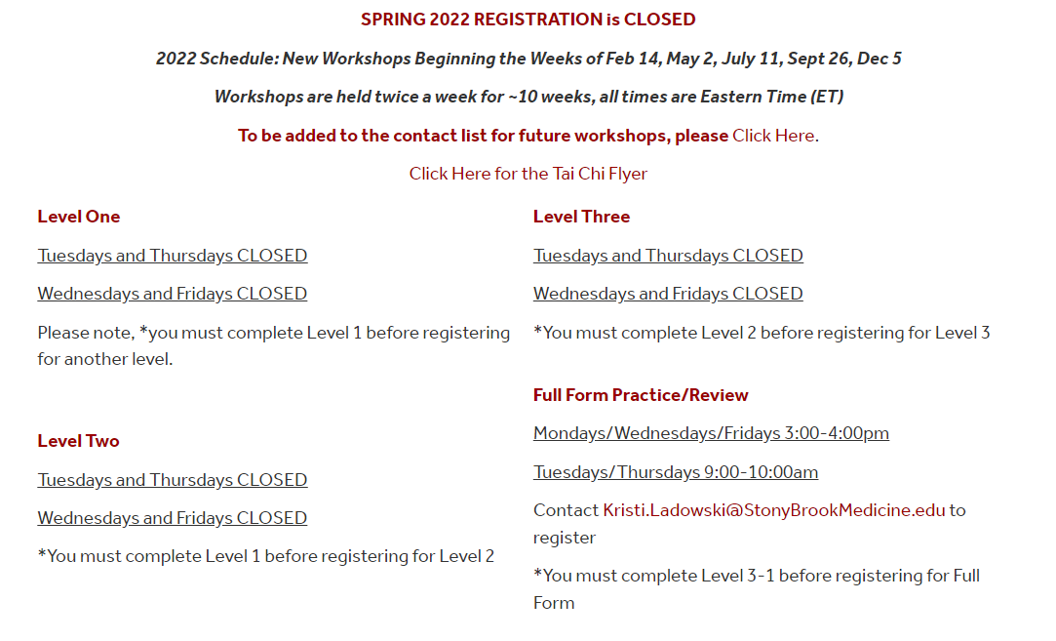
Schedules
Series every 10-12 weeks
2 Workshops Levels on varying days/times
Part 1 W/F 4pm
Part 1 T/Th 10am
Notes:
To help increase participant completion rates, we extended the length of workshops and allow participants to join multiple workshops
This led to issues with tracking one participant across multiple workshops
Accurately tallying complete attendance
Knowing if they are a beginner vs. advanced participant

Slide 10
Applying Data Collection Lessons Learned

Slide 11


Registration/Data Collection
Zoom® Registration/Consent/ICE
Qualtrics® Pre/Post Surveys
Excel Attendance
Notes:
Dunya-are you comfortable leading these slides?
All the participants are independently filling out their registration and surveys and we take their attendance
This creates 3 separate data reports that need to be merged
First had to figure out how to give a unique identifier because hand typed emails and codes for surveys created merging problems

Slide 12
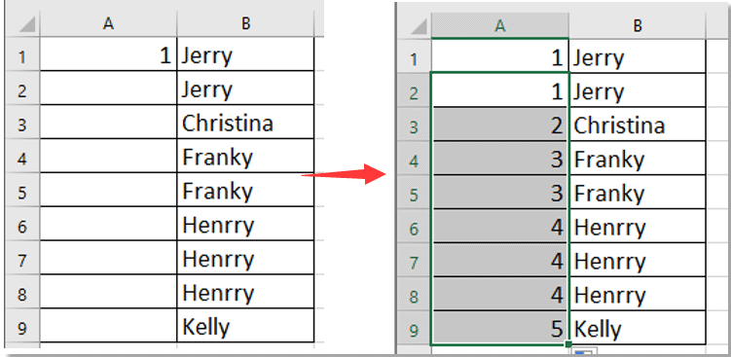
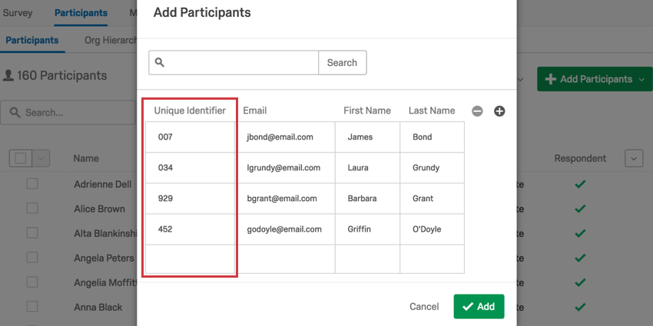
Unique Identifier
REGISTRATION/ATTENDANCE
QUALTRICS SURVEYS
Notes:
We use the registration reports to assign a unique ID, also use to collect attendance
Now all 3 data reports have a unique ID to merge registration/demographic data with attendance and survey results
Still need to manually account for one participant in multiple workshops
Upload the registration report with unique id into Qualtrics and email the participants their survey links
Can track who did/did not complete to send gentle reminders

Slide 13
Dunya-do you want to add some results here from Spring 2022 with unique IDs?

Slide 14
(Very) Prelim Results

Slide 15
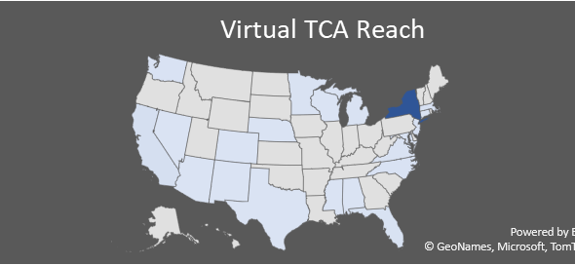
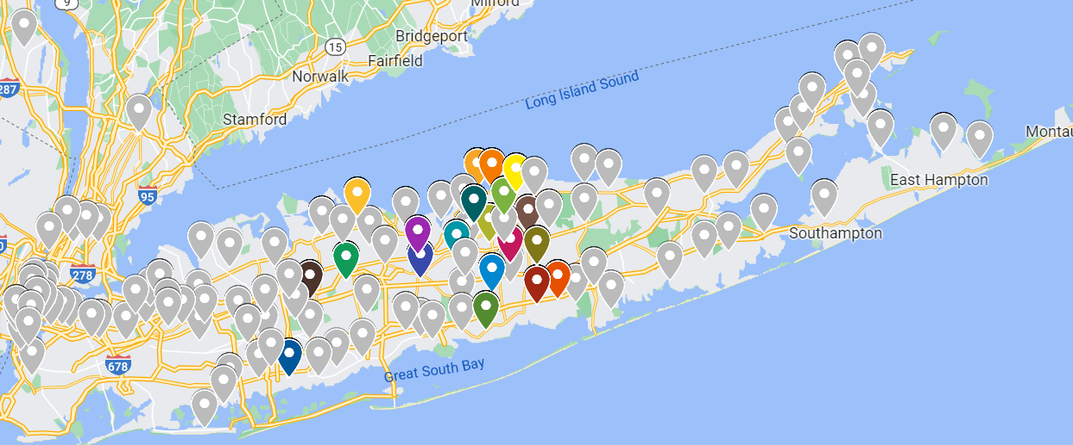
Virtual Tai Chi Reach
Word of Mouth!
Notes:
Just a general idea of how we are reaching people without boundaries and it’s mostly word of mouth

Slide 16



Research/Evaluation
Sample Hypotheses:
1. More participants register, but never attend a workshop in the virtual delivery as compared to the in-person
2. Attrition is greater in the virtual delivery for beginner levels, as compared to in-person
3. Attrition is less in the virtual delivery for advanced levels, as compared to in-person.
Notes:
Would like to track referral method to see if we can increase the clinician referrals
May also want to track what type of device the participant is using
Other ideas for new data elements to track?

Slide 17
Fall 2021 Workshops
The overall completion rate
The completion rate by levels
Across 8 sessions in Fall 2021
56 completers
Completion rate is 11.40% (=56/491)
For the overall completion rate, attendance from 8 sessions are summed up as the total number of participation
Part 1: Completion rate is 4.08% (6/147)
Part 2: Completion rate is 6.45% (4/62)
Part 3_1: Completion rate is 13.56% (8/59)
Part 3_2: Completion rate is 30.17% (35/116)

Slide 18
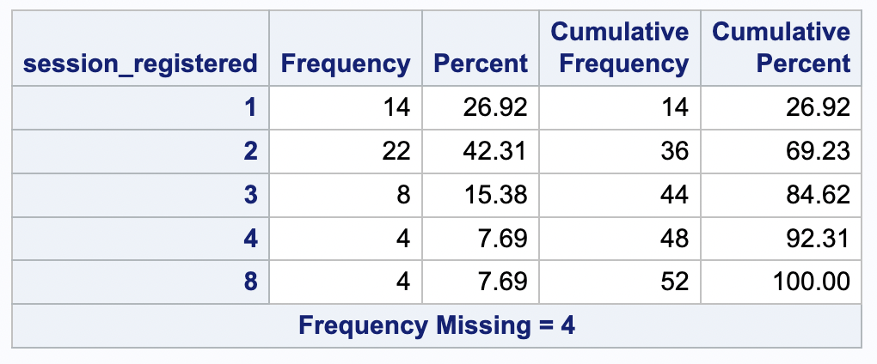
Total number of sessions registered among Completers

Slide 19
Relationship between Number of Session Registered and Completion Rate
Number of Sessions | Completers | Non-completers | Ratio
1 | 14 | 285 | 0.049
2 | 22 | 109 | 0.202
3 | 8 | 17 | 0.471
4 | 4 | 18 | 0.222
5 | 0 | 1 | 0
8 | 4 | 6 | 0.667
Total | 52 | 436

Slide 20


